Slide 1
Cultural Diplomacy in Conflict Zone
Bushra Hashmi

Slide 2
INTRODUCTION:
Geoffrey Berridge, Diplomacy. Theory and Practice (2010): „Diplomacy is an essentially political activity, its chief purpose is to enable states to secure the objectives of their foreign policies without resort to force, propaganda, or law. It follows that diplomacy consists of communication between officials designed to promote foreign policy”.
Cultural diplomacy is a type of public diplomacy and soft power that includes the "exchange of ideas, information, art, language and other aspects of culture among nations
Diplomacy has always been related to the crucial task to protect interests.
Fred Iklé (How Nations Negotiate,1964, Diplomacy has the ultimate goal to promote peace and to solve conflictual situations by peaceful means. Negotiation is deeply linked to Conflicts, and this relation is an important aspect of Diplomacy.

Slide 3
BACKGROUND STUDY
Since the existence of civilization people and individuals have been practicing and involved in creating relationships or alliances with each other.
Different tribes, clans, communities and even in war-like situations, people have kept their ties with one another.
In earliest time of development Messengers, diplomatic/political agents, Kings/queens were first of their kind who conducted these jobs effectively for their states.
Cultural diplomacy has long existed as a tool of international affairs.
However, only recently have academics initiated to evaluate its nature and impact.

Slide 4
TYPES OF CD: SOFT POWER & HARD POWER
Positive Cultural Diplomacy - involves „the power of persuasion, when a state actively supports cultural exchange and the use of soft power initiatives to strengthen intercultural relations as well as promote national interests”.
Negative Cultural Diplomacy – refers to „the restriction or limiting of cultural interactions by the state to protect its national image or interests”.
As compared to the ‘hard power’ of military might, the ‘soft power’ of cultural diplomacy has often been deeper, lasting, and persuasive.

Slide 5
How can we Apply CD in Conflict Zone?
The actual implementation of CD started after the II world war when Britain and US try to ease down the tension in Europe and started investing in different EU development programs.
In order to ensure prompt and effective action by the United Nations, its Members confer on the Security Council primary responsibility for the maintenance of international peace and security and agree that in carrying out its duties under this responsibility the Security Council acts on their behalf.
UN article 24 specifically promote the idea of Peace Making and Peace keeping.
This underlying concept is captured in the Vienna Convention on Diplomatic Relations (1961) – article 3:

Slide 6
Case Study Analysis in CD-Conflict Zone
The Historical Context in which the cultural diplomacy case study was developed.
2. The Agent that promoted the cultural diplomacy initiative.
3. The Agenda put in practice by the Agent.
4. The Vehicle that was used for implementing the cultural diplomacy initiative.
5. The Target Audience for the Agent practicing cultural diplomacy.

Slide 7
OSCE Instruments:
Since 1990’s, the OSCE(Organization for Security and Co-operation in Europe) evolved as the primary instrument for:
a). Early warning;
b). Conflict prevention;
c). Crisis management;
d). Post-conflict rehabilitation.

Slide 8
CD In Conflict Zone: Bosnia Conflict:
Tension started when in 1991 proclamation of Slovenia and Croatia independence - upset the delicate balance of power within Yugoslavia, many cases of mass killing were recorded espically in bosnia and hasogovina
The Stari Most (Old Bridge) at Mostar reopened in July 23rd, 2004, more than four centuries after it was first erected, and a decade after it was deliberately destroyed by Croat tank shells during the Bosnian war (in 1993).
The reconstruction was promoted by the World Bank, UNESCO, the Aga Khan Trust for Culture and the World Monuments Fund. It was funded by the U.S., Turkish, Italian, Dutch and Croat governments, among others.
UNDP Project 2010- reconstruction of the Ferhadija Mosque in Banja Luka, to promote peace
Impact in Kosovo-The Graz Process” was related to the issue education that was entrusted to Working Table I of the Pact. It was designed to promote the democratic and peaceful development of the South Eastern European region by supporting and coordinating education-related projects.

Slide 9
CD In conflict Zones: Examples
Middle East Conflict
Student exchange program between EU and US
Marshal plan
China US –Hollywood CD

Slide 10
Pakistan-India Conflict and CD
Asia Singing Superstar, broadcast on pakistani channel GEO TV from, 31 October 2015 – 30 January 2016, judge by Shafqat Amanat Ali, Shankar Mahadevan, Ghulam Ali, Suresh Wadkar
Sur Kshetra is a 2012 singing talent show or musical battle between teams of two neighboring countries: Pakistan(Atif Aslam) and India(Himmesh Rashmiya), judge by Abida Parvee, Asha Bhosle and Runa Laila
Atif Aslam, who used to be part of the band Jal, is another one of Bollywood’s biggest imports from the neighbour.
Cricket Diplomacy
Kartar Poor Boarder

Slide 11
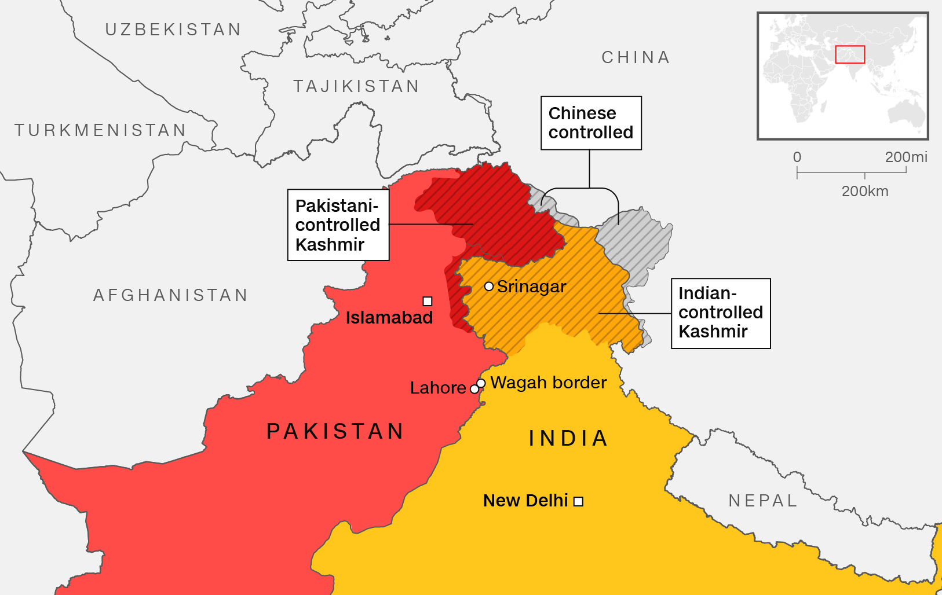
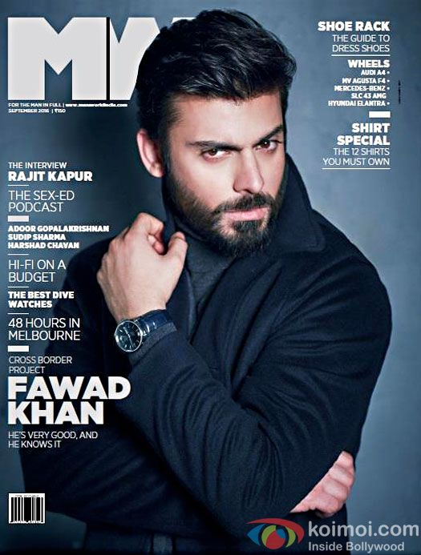

Pakistan-India Cultural Diplomacy
Pakistan two famous actors on Indian magazine cover

Slide 12
Thank You

